Slide 1
Small Islands Organisation
One year on islands
SMILOCulatra2022

Slide 2
smilo
community led solutions for
sustainable island development
1 year on islands …
1
SOLUTIONS
2
COMMUNITY & LABEL
3
PERSPECTIVES

Slide 3
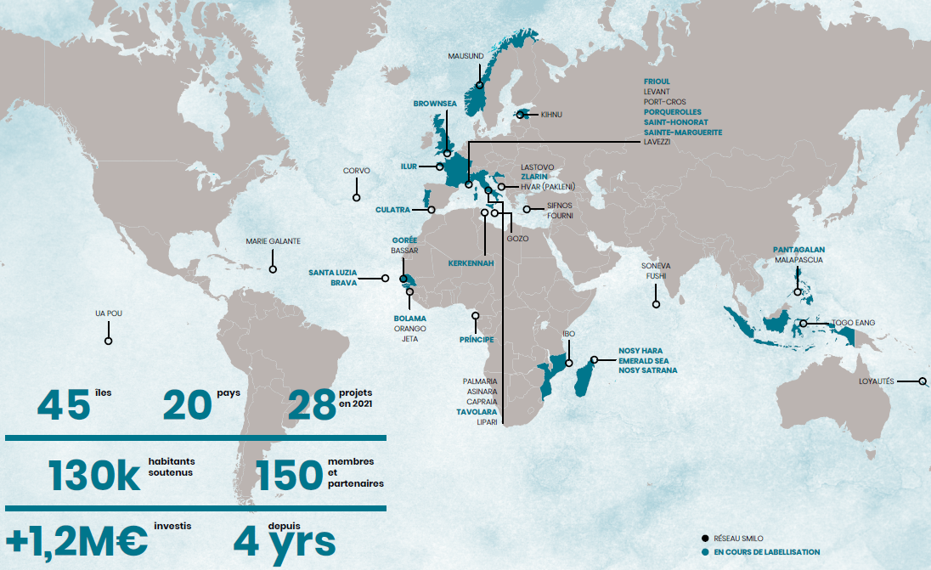
A growing international community

Slide 4
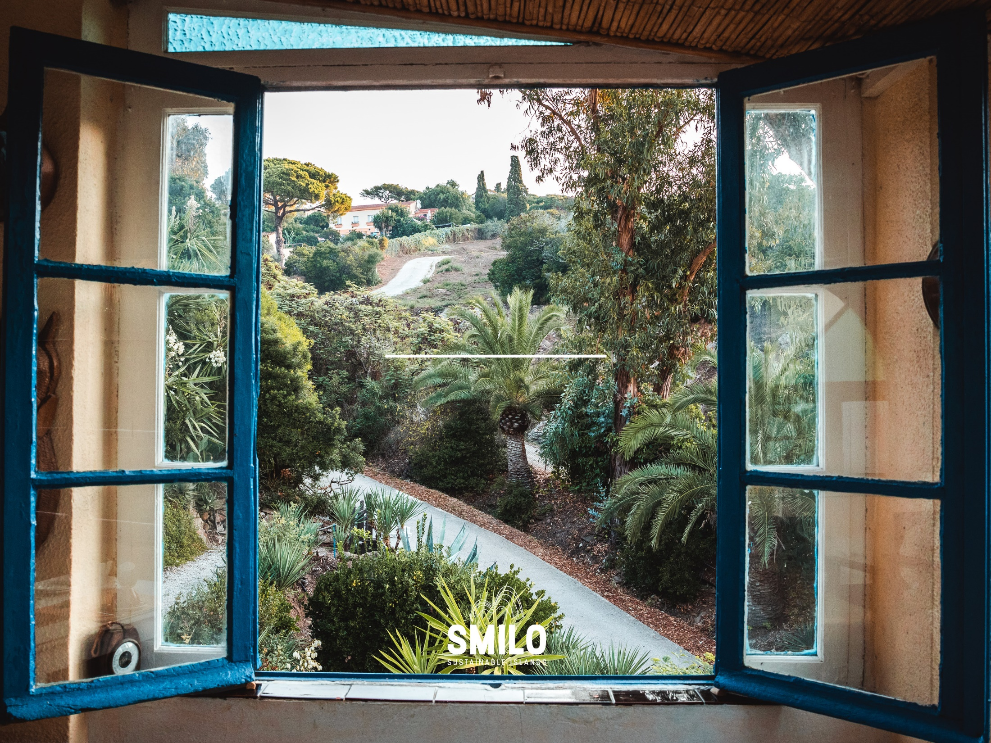
smilo
community led solutions for
sustainable island development
Solutions !

Slide 5
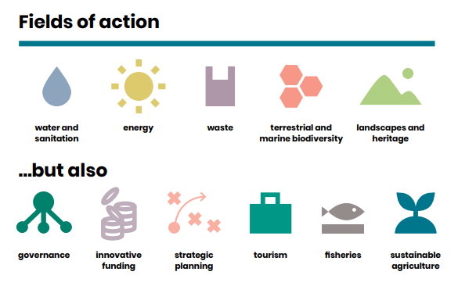
Solutions !

Slide 6
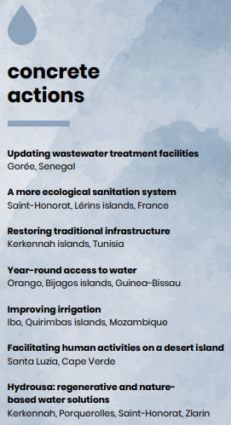
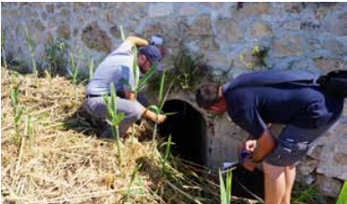
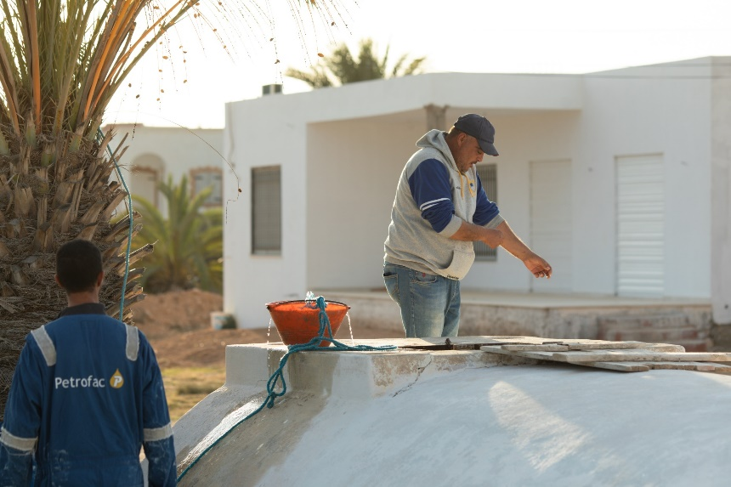
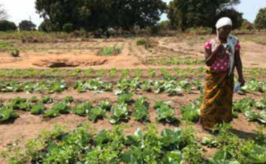
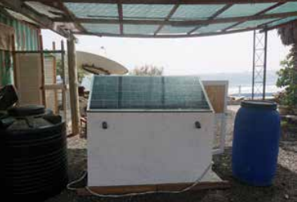
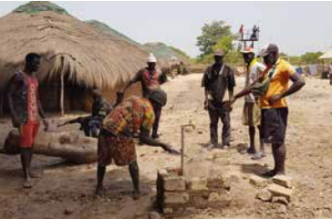
Notes:
DLH – Saint-Honorat, Kerkennah, Ibo, Santa Luzia teaser

Slide 7
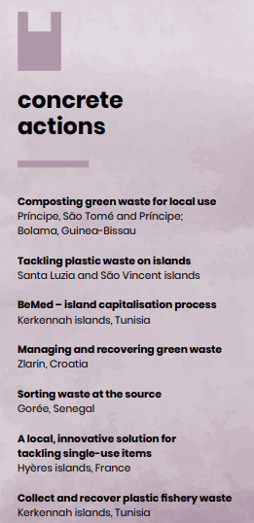
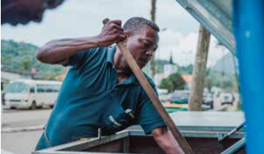
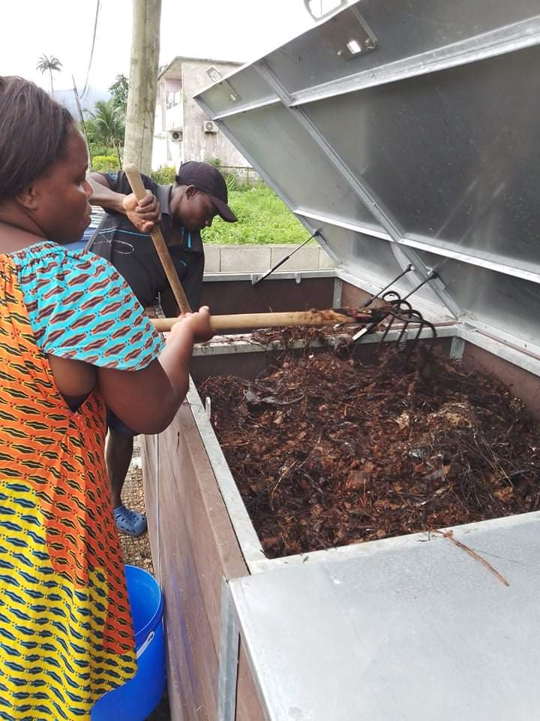
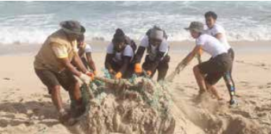
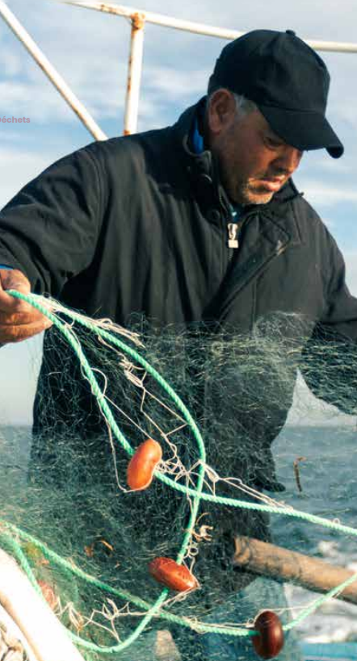
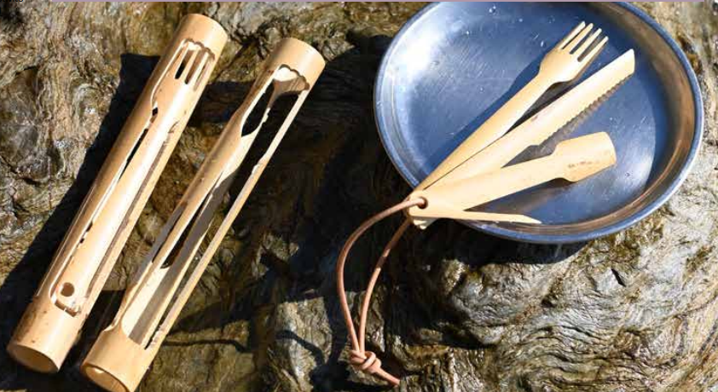
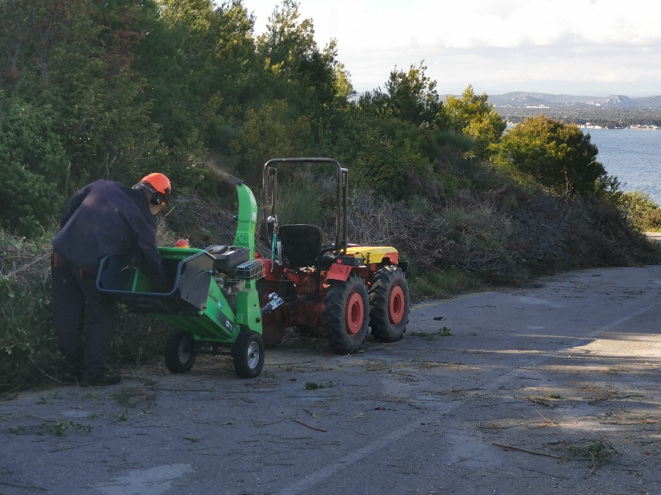
Notes:
Mf

Slide 8
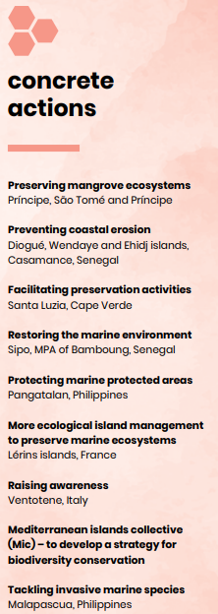
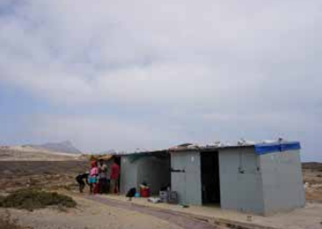
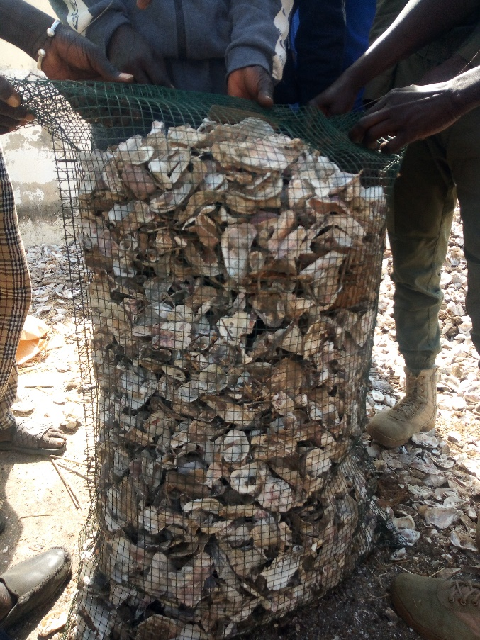
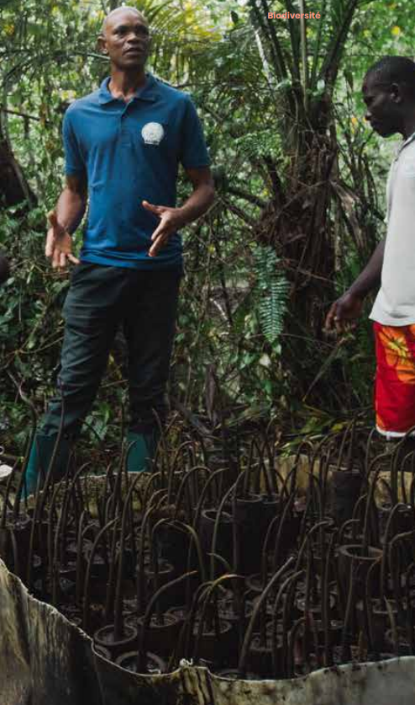
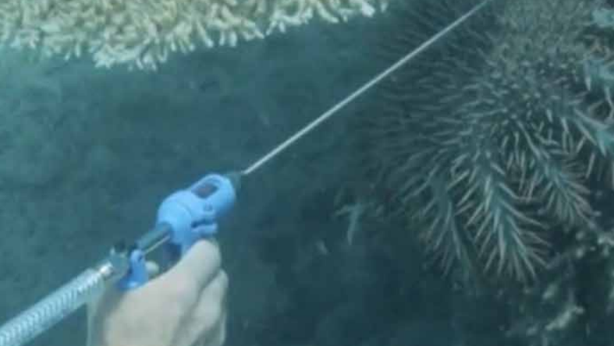
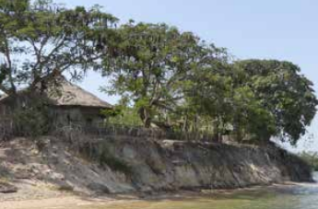
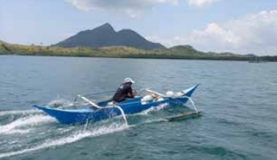

Slide 9
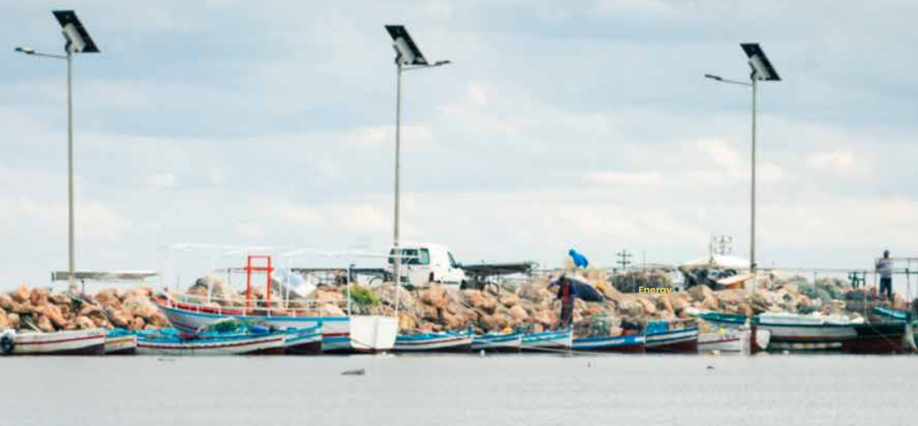
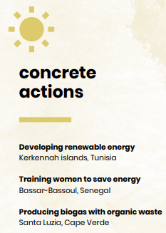
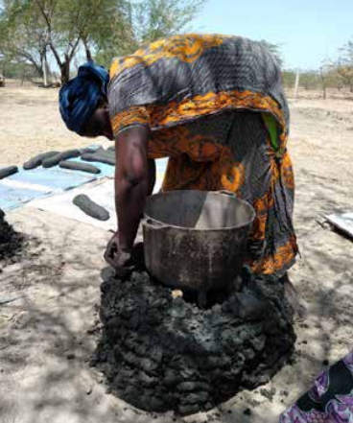
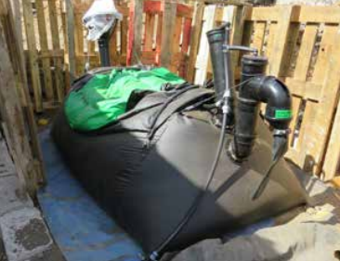

Slide 10
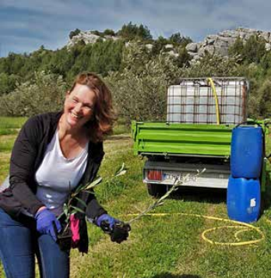
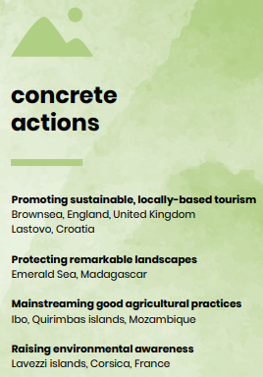
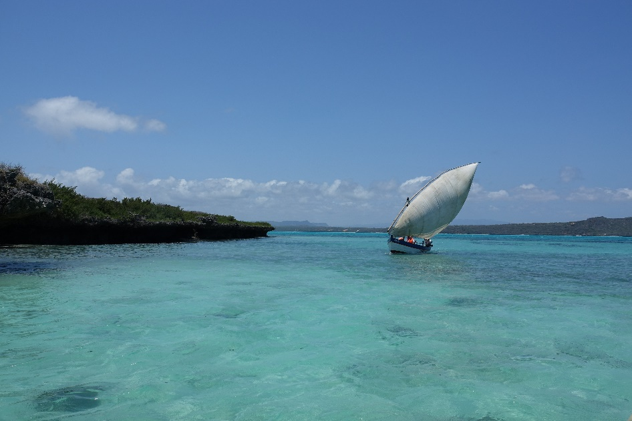
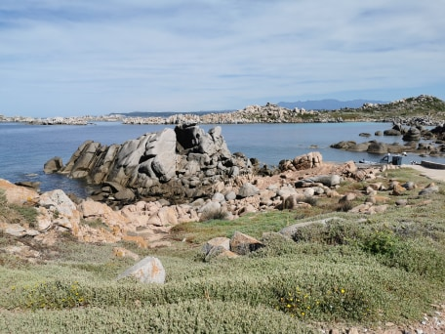
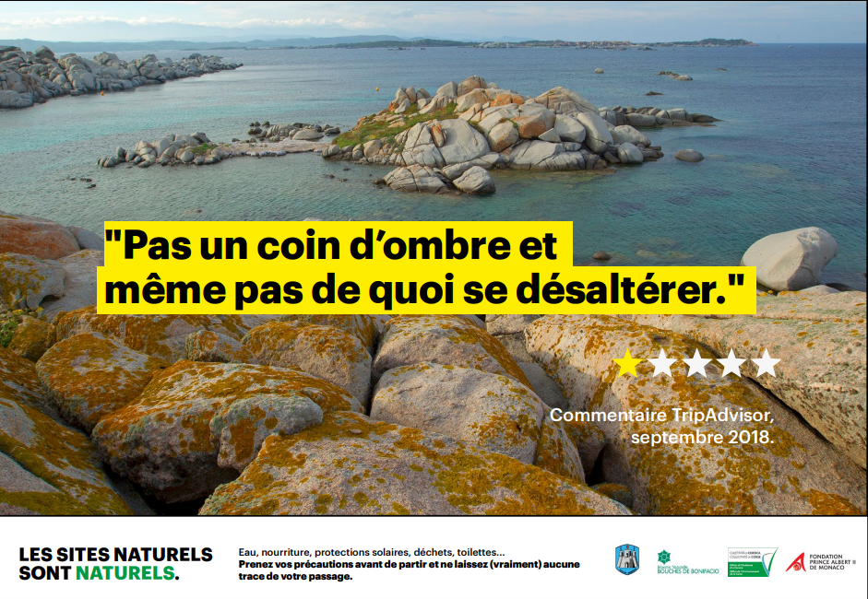

Slide 11
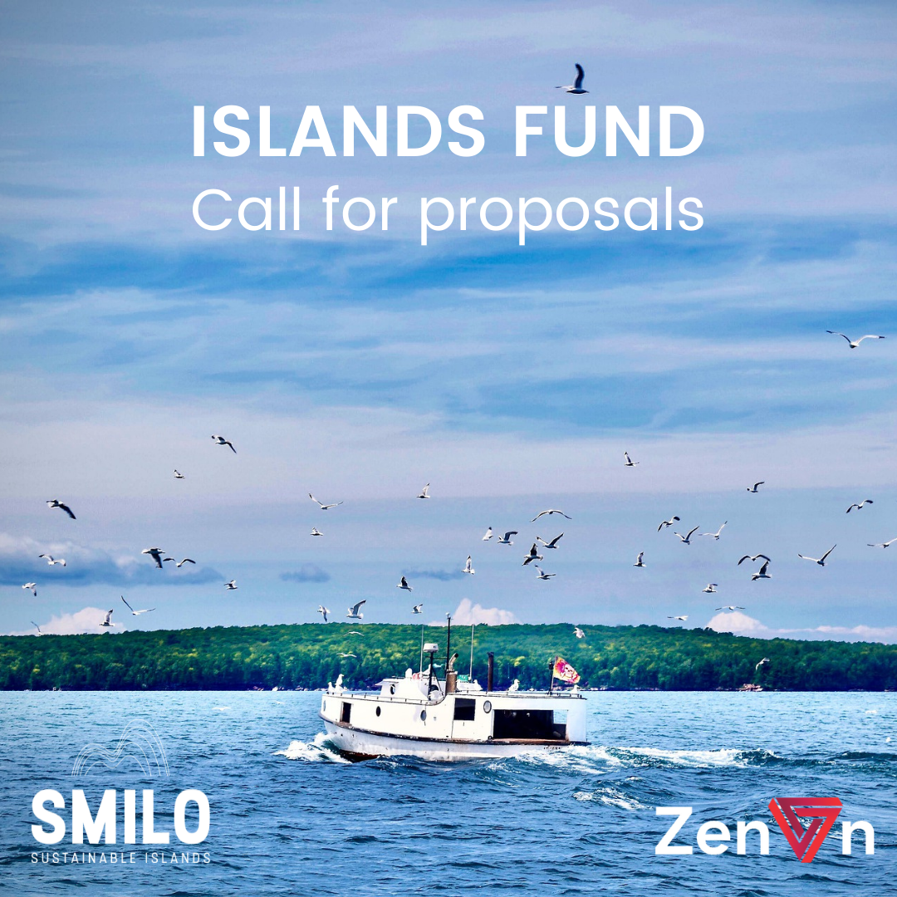
smilo
community led solutions for
sustainable island development
who we are
Islands involved in the SMILO label process or active members of the network
For local organisations, with a focus on the civil society organsiations
50000€ in total: grants from 1000€ to 15000€
Project lasting 1 year: June 2022 until July 2023 (1 year)
Solutions for sustainable energy, fisheries, maritime ecosystems protection, focus on blue carbon!

Slide 12
smilo
community led solutions for
sustainable island development
who we are
CULATRA (Portugal) Centre for Marine and Environmental Research / University of Algarve
>> Solar desalinization system
2. NEVIS (San Kitts & Nevis) Nevis Historical & Conservation Society
>> conservation and restoration of coastal wetland ecosystems with actions against invasive species, and mangrove replanting
3. RAJA AMPAT (Indonesia) The SEA People & Orang Laut Papua
>> Autonomous solution: solar system for a floating scientific and coral restoration base
4. PANAGATALAN (Philippines), Fondation Sulubaaï
>> Diving trainings for local volunteers for the realization of ecological monitoring
5. SIPO (Senegal), FENAGIE PECHE
>> Enhance the shell-made artificial reefs system + ecological monitoring
6. KERKENNAH (Tunisia), Kratten pour le Développement
>> Restoration of marine ecosystems with the installation of artificial reefs made of date palms

Slide 13
OUR COMMUNITY

Slide 14
smilo
community led solutions for
sustainable island development
NEW ISLANDS IN THE LABELlING PROCESS IN 2022
- Gombrani (Rodrigues, Mauritius)
- Gozo (Malta)
- Chole & Jibondo (Tanzania)
- Ilur (France)
- Nosy Satrana (Madagascar)
- Tiga & Ouvéa (Nouvelle-Calédonia)
ISLANDS CANDIDATE TO THE LABEL
Frioul
Culatra
Ouvéa
Brownsea

Slide 15
smilo
community led solutions for
sustainable island development
Main technical and financial partners

Slide 16
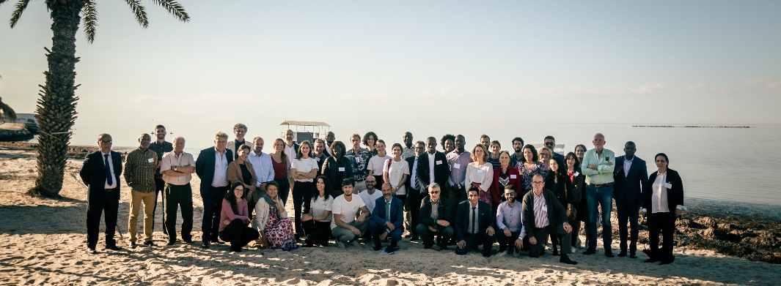
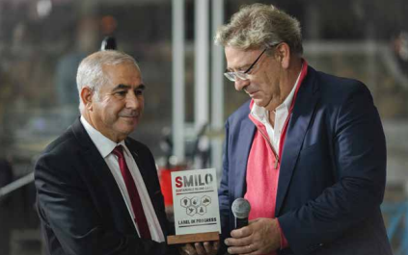
smilo
community led solutions for
sustainable island development
Annual Meeting - Kerkennah 2021

Slide 17
ONLINE TRAINING SESSIONS – project building and management / sept-nov 2021
Project designing
Project management
Reporting and communication

Slide 18
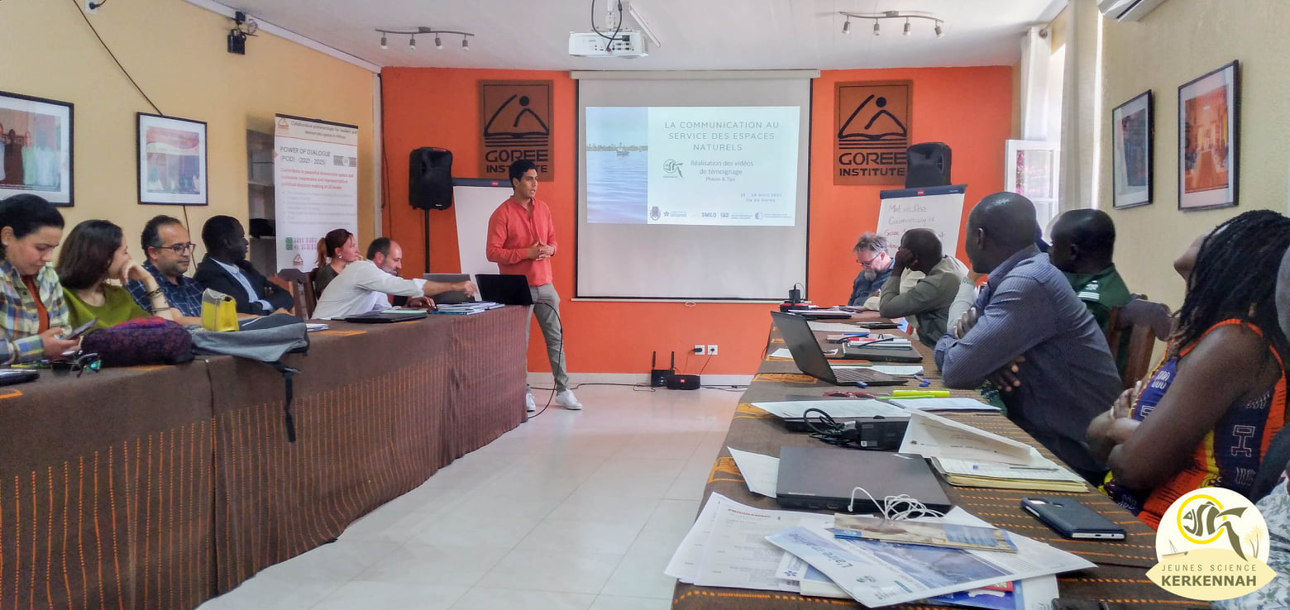
smilo
community led solutions for
sustainable island development
TRAINING ON COMMUNICATION AND MANAGEMENT OF VISITORS IN GOREE SENEGAL
25-28 APRIL 2022
Teachings and participatory workshops allow partners to exchange on the development of a communication stratgy and its implementation + introduction to the theory of change

Slide 19
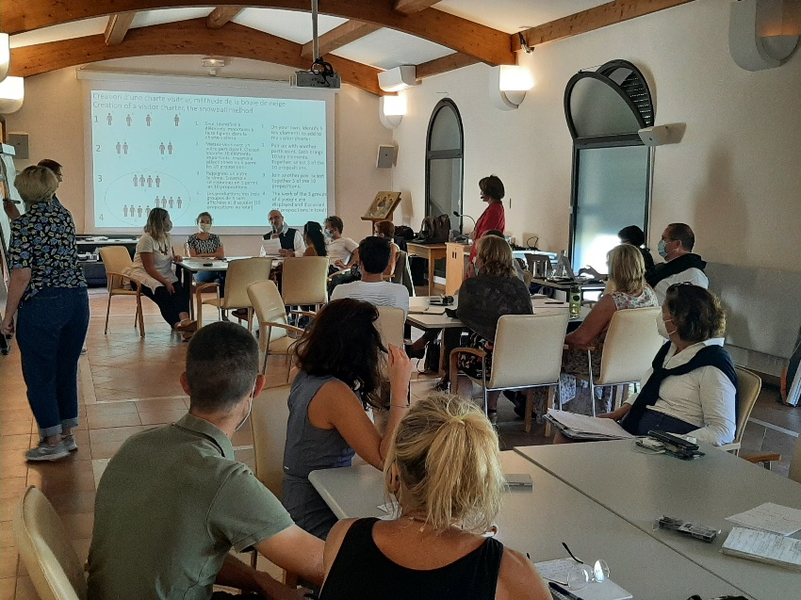
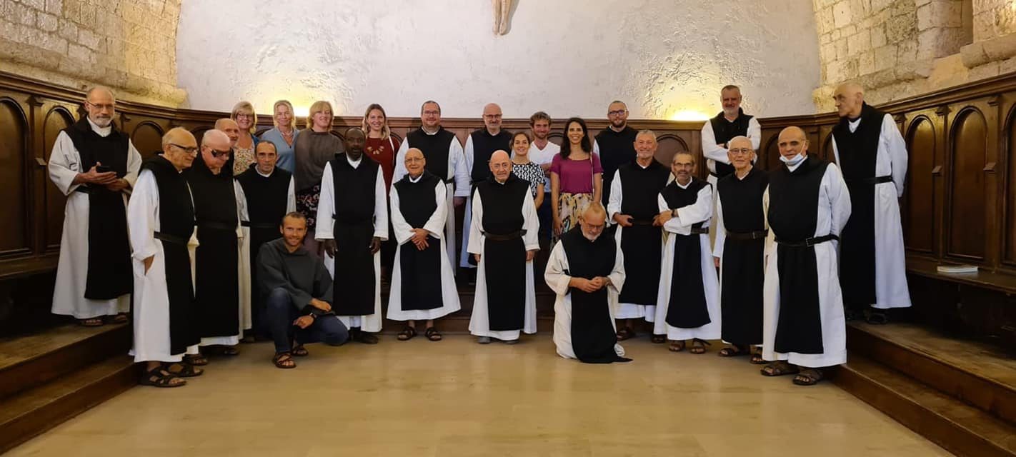
smilo
community led solutions for
sustainable island development
ERASMUS+ Strategic Partnership Sustainable tourism
>> Technical workshops : inter-islands visits
St Honorat
Mausund
Brownsea
Zlarin

Slide 20
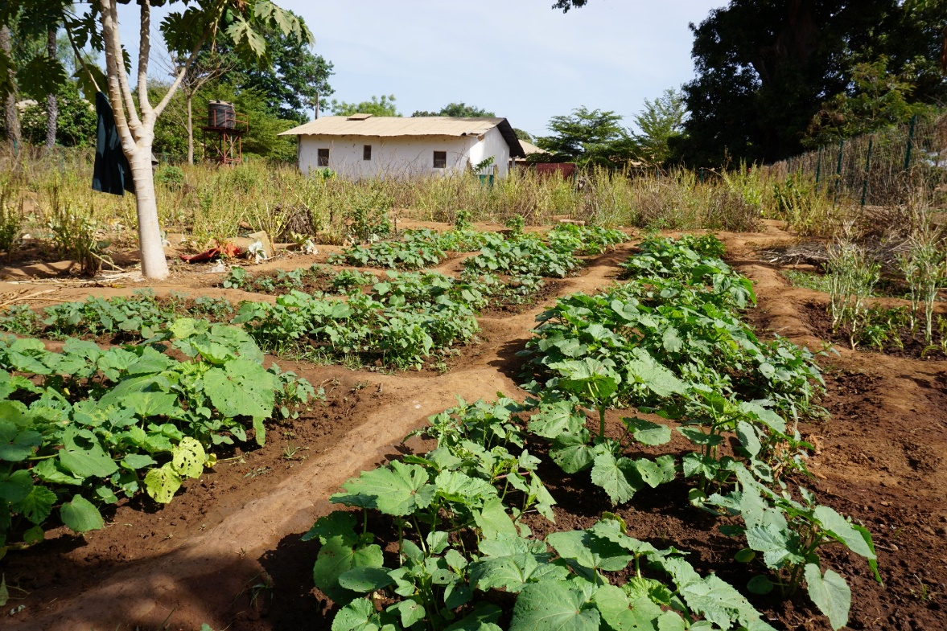
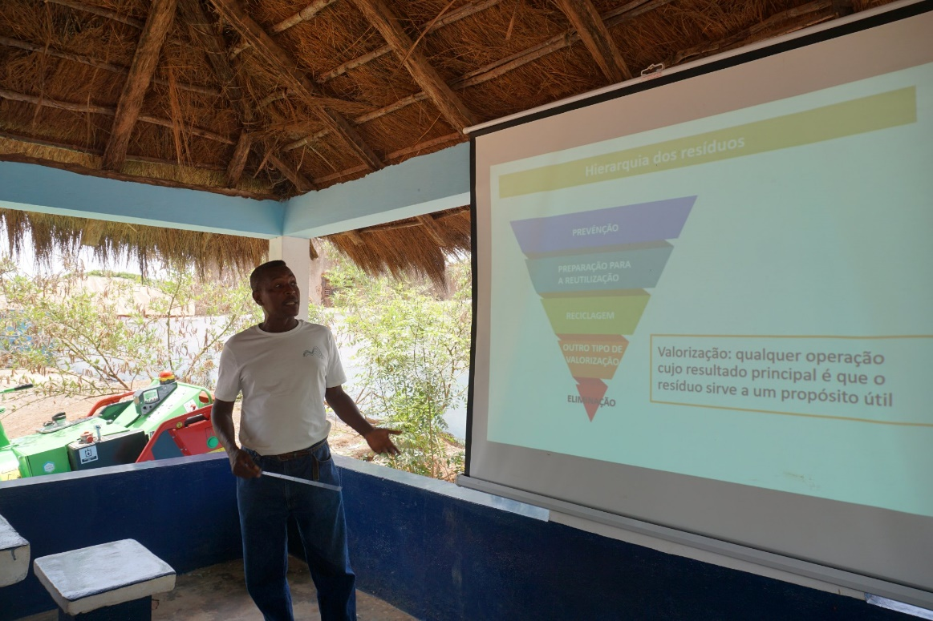
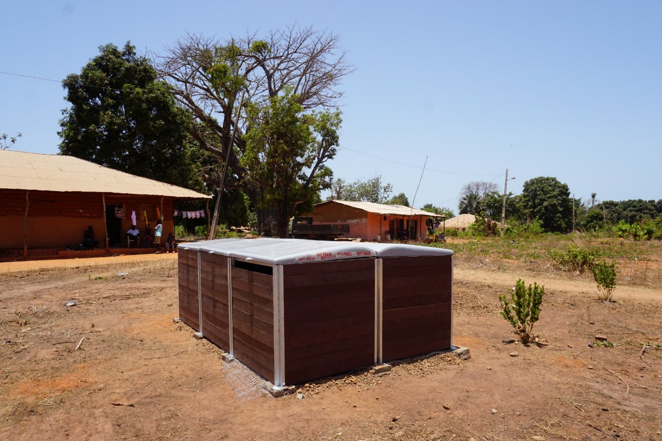
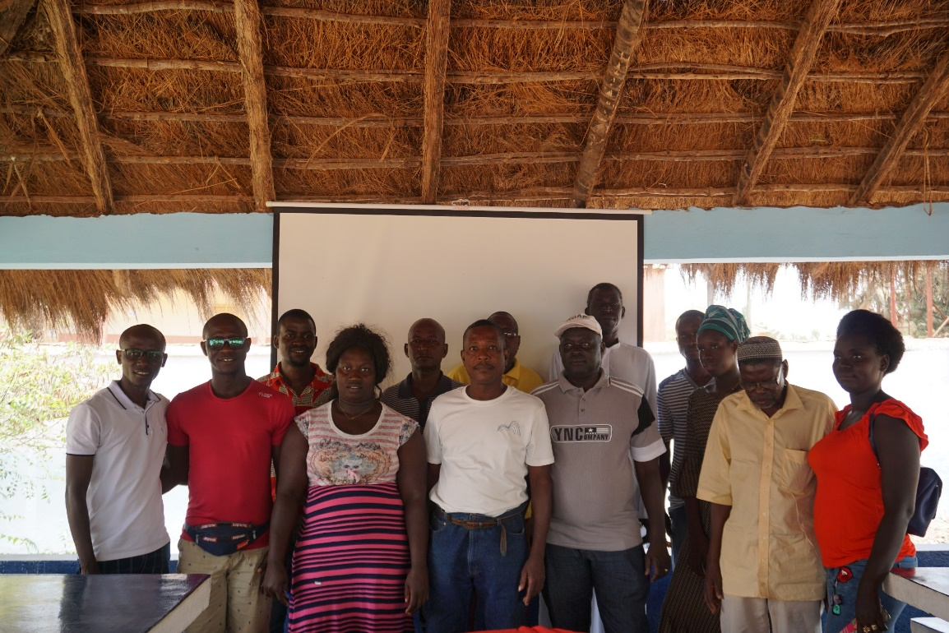
smilo
community led solutions for
sustainable island development
Organic waste composting & green waste shredding
Principe island <> Bolama island

Slide 21
smilo
community led solutions for
sustainable island development

Slide 22
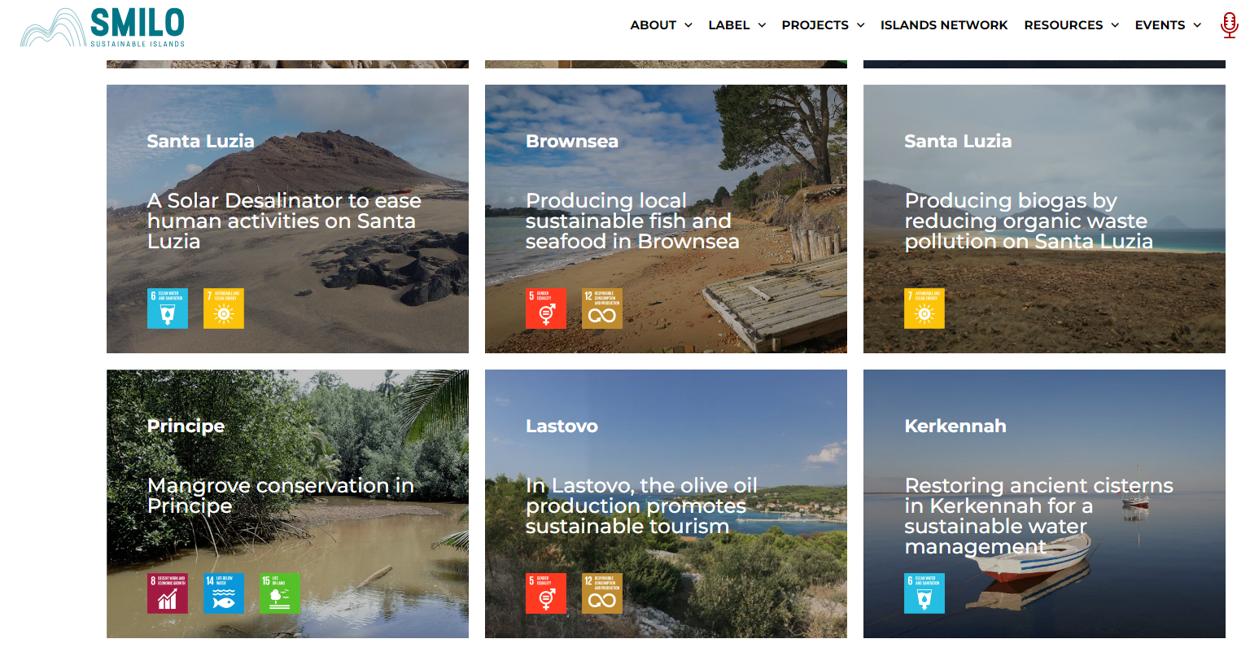
smilo
community led solutions for
sustainable island development
PODCAST
NEW WEBSITE
Catalogue of actions & good practices
Notes:
Catalogue

Slide 23
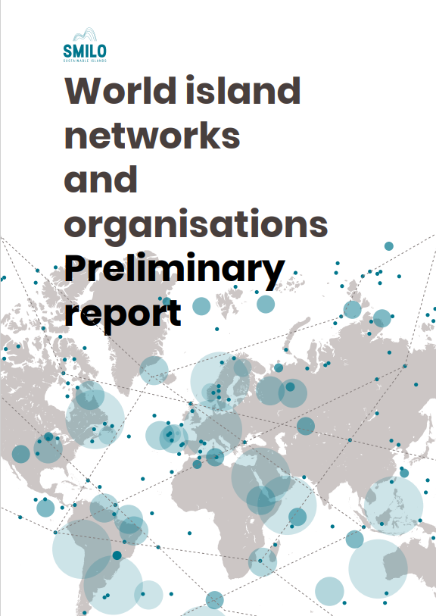
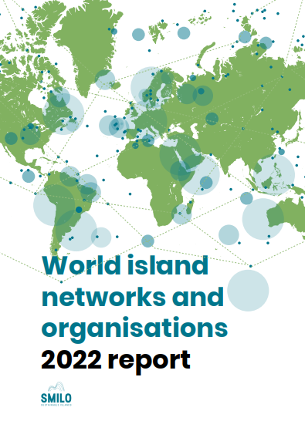
smilo
community led solutions for
sustainable island development
World Island Networks
120 networks identified
72 ANSWERS
400 participants
68 nationalities
>> Presentation of the results end of 2022

Slide 24
Lessons learnt & contribution to policies by the #BEMEDIslands community to stop plastic pollution on Mediterranean islands: Technical Sessions + Policy paper at the Barcelona Convention

Slide 25
2023
An initiative deployed
Definition of a clear and ambitious roadmap, via a new strategy, to ensure a sustainable change of scale + Communication Strategy
A strategy to lay down the axes of work to ensure the sustainability of the association, its label and the animation of its community of practice

Slide 26
Coming events
MANGROVES planting and restoration Guinée-Bissau – 2022
UPSCALING GLASS WASTE Gorée, Sénégal – 2023
TRAINING WORKSHOP ON SUSTAINABLE WASTE WATER MANAGEMENT St Honorat - 21-23/11/2022
PLASTIC WASTE MANAGEMENT & CIRCULAR ECONOMY ON ISLANDS Frioul – 8-11/2022
Presentation of the « Mapping of island networks and oréseaux et organisations insulaires » To be defined
Side event COP27 UNFCCC on the French Pavillon « small islands resilience, dialogue between SIDS and other islands » nov. 2022 - To be confirmed
IMPAC 5 side event with Apolimer-CNRS "Indigenous peoples and local communities for the conservation of marine biodiversity around the world », Vancouver, Canada – 02/2023
ISOS + « sustainable agriculture » - 03/2023 (to be defined)
Series of trainings in the framework of the French development agency project Rest’île – 2023, to be defined

Slide 27
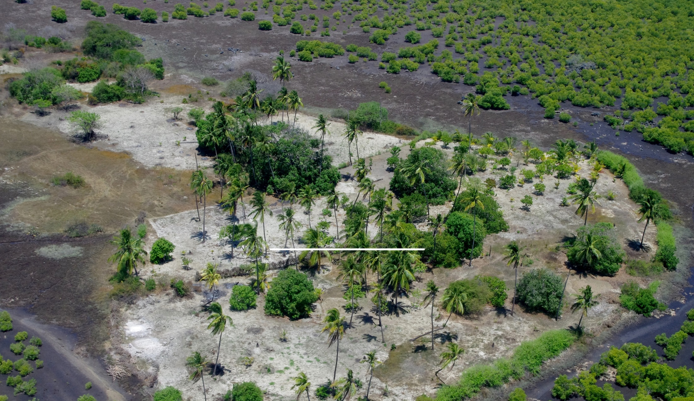
OBRIGADO
#SMILOCulatra2022
Bastide Beaumanoir, 3 rue Marcel Arnaud
13100 – AIX-EN-PROVENCE
+33 4 42 91 64 22
secretariat@smilo-program.org
Follow us !

