Slide 1
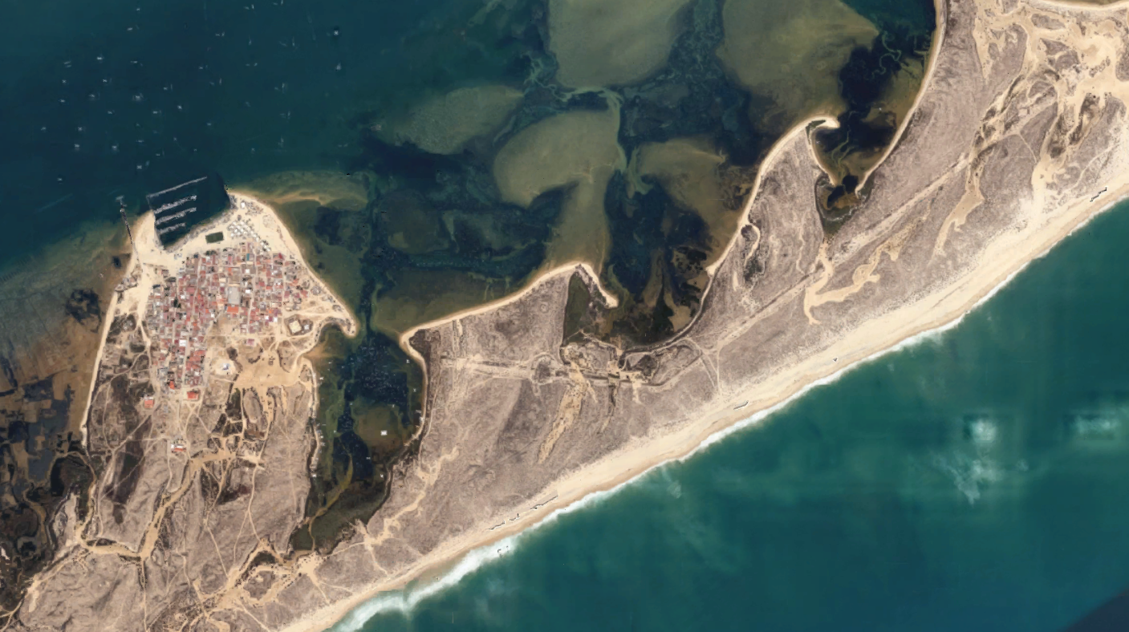
CREATING AN ENERGY
COOPERATIVE
Jóni dos Santos│jnsantos@ualg.pt
SMILO ANNUAL CONFERENCE 2022 Tuesday, 27 september 2022

Slide 2
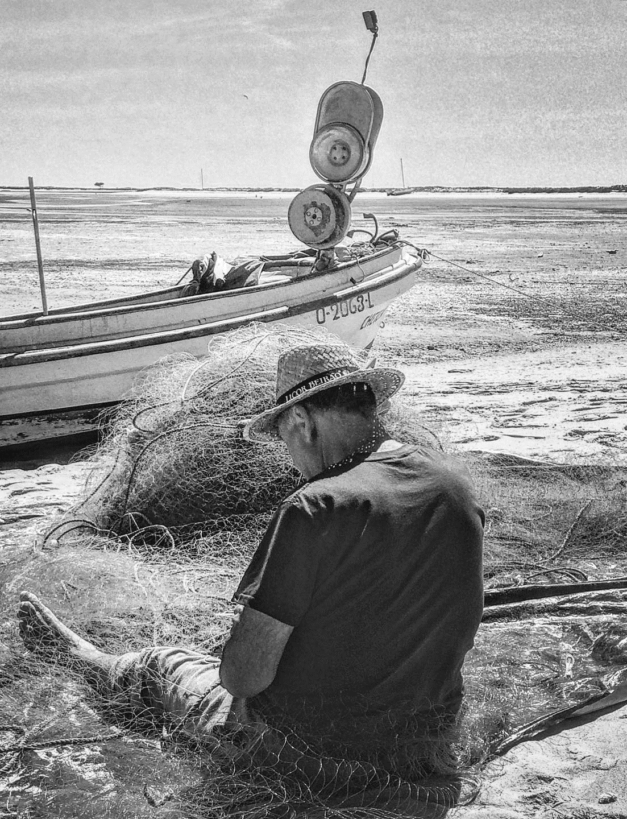
1
Culatra Coop Cooperative for the Sustainable Development of Culatra
Founded in the scope of Culatra2030 Initiative
Empower the community to continue Culatra2030 work
Cover all the socioeconomic activities
To Preserve Culatra’s Identity as a Consolidated Fishing Settlement
Fábio Buchinho Facebook
Notes:
Objetivo principal: Preservar a entidade da Culatra como nucleo de pescadores consolidado, enquanto melhora a qualidade de vida dos seus habitants (investir no mercado descentralizado de energia, combater a desigualdade, inovar nas principais atividades económicas)

Slide 3
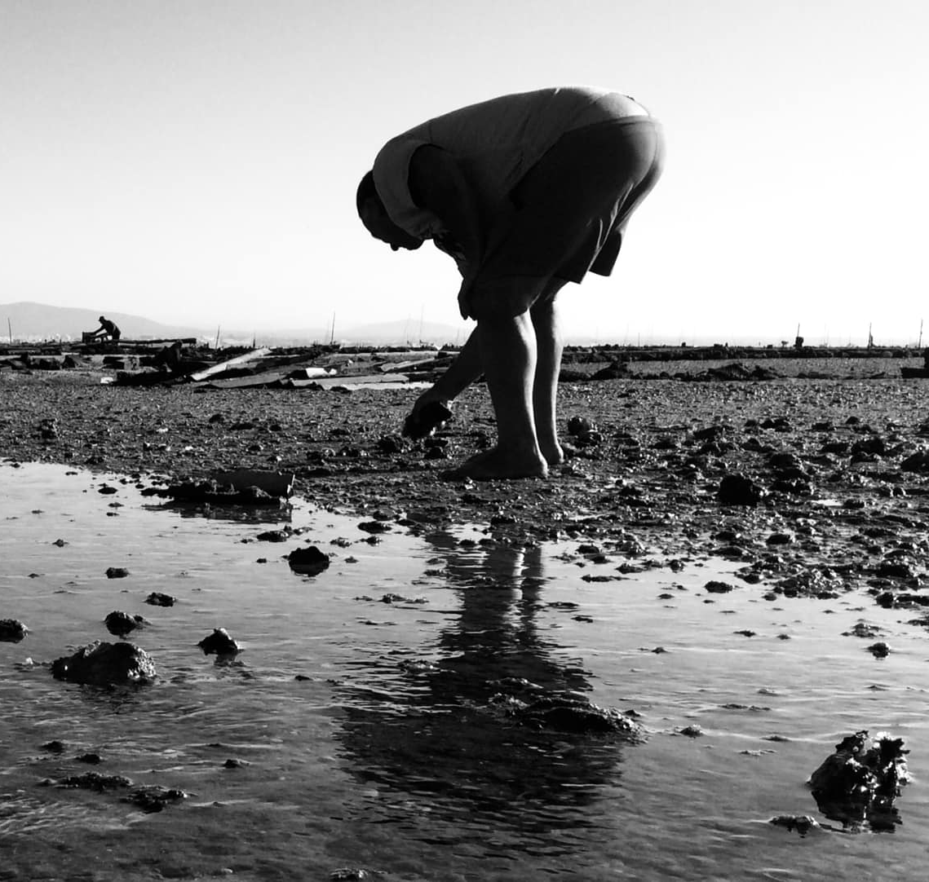
2
Our Team
eatery
health
minimarkets
energy
fishing
sports
100% Culatra People
Divided by all Socioeconomic Activities
AMIC, ANSN & CUC Founders
associativism
bivalve farming
Fábio Buchinho Facebook
waste management
Supported by an Advisory Council
communication

Slide 4
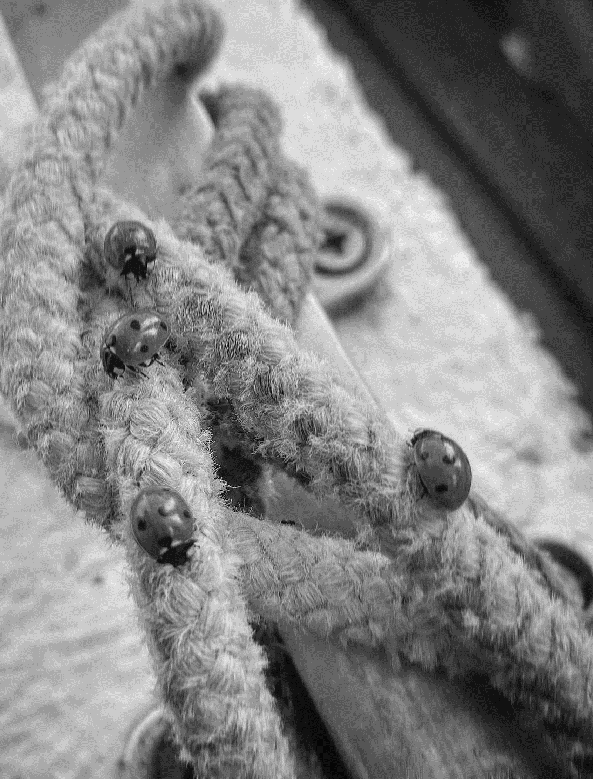
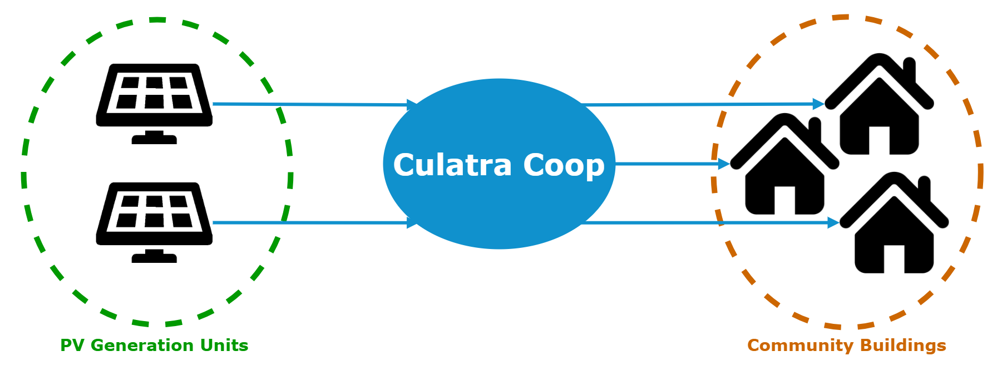
3
Renewable Energy Community
Collective Autoconsumption Management Entity
Manage all the PV generation units
Share the renewable energy with the community
Pilot-project to test new energy sharing models
Renewable Energy Community
Fábio Buchinho Facebook

Slide 5
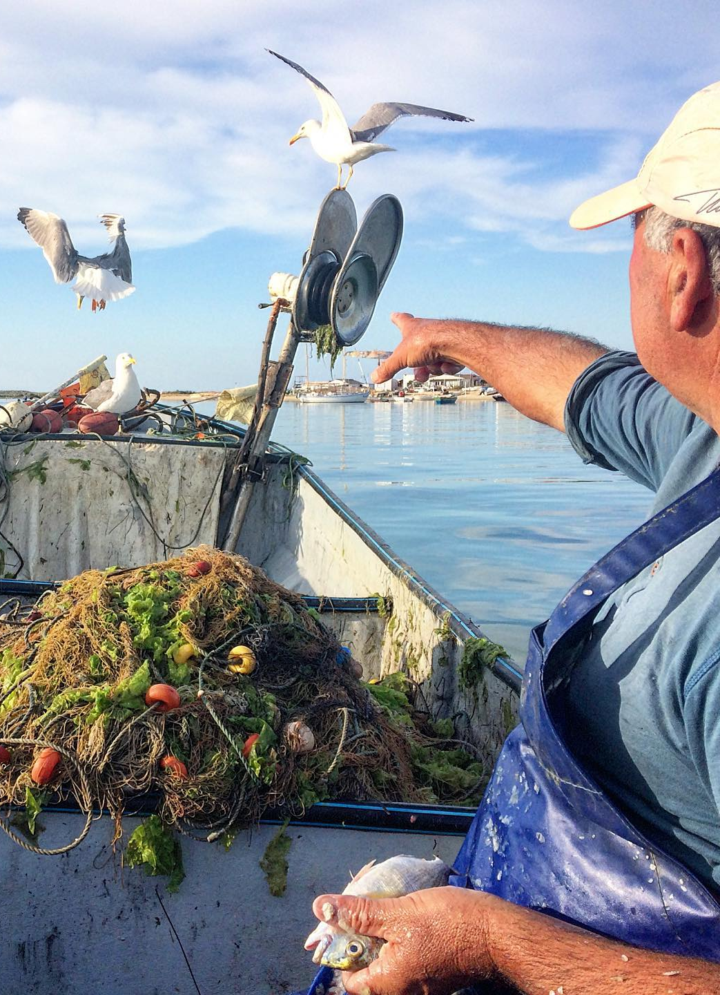
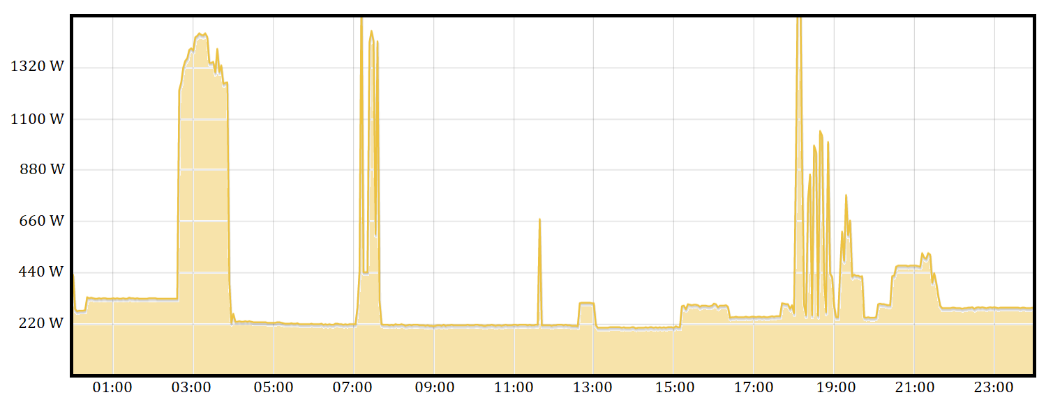
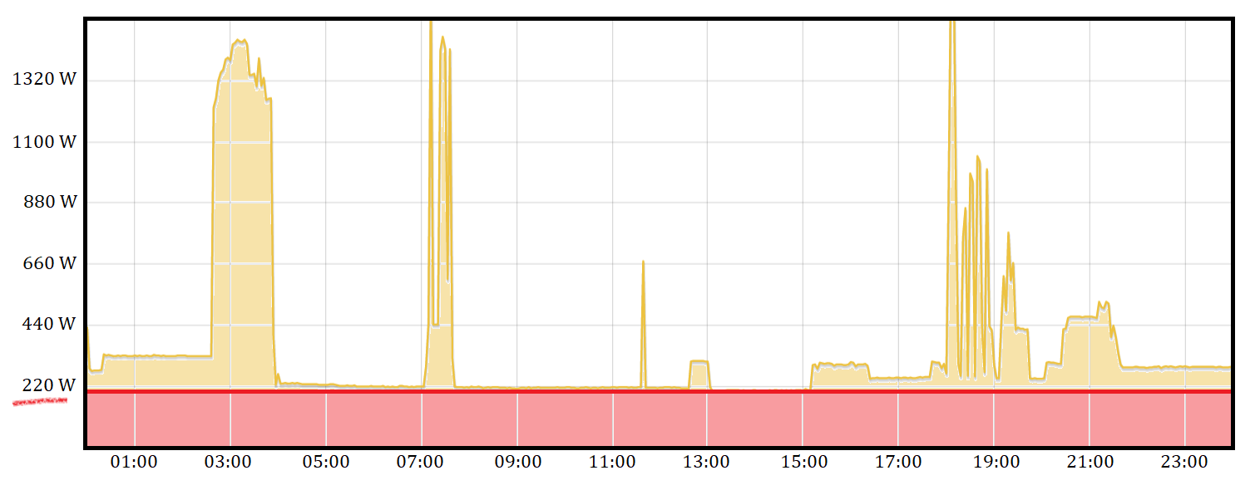
4
Energy Sharing
60 000 Wp installed in PV (60 kWp)
300 buildings equipped with smart meters
Common Daily Energy Consumption
Fábio Buchinho Facebook
≈ 220 W uninterrupted power consumption / building

Slide 6
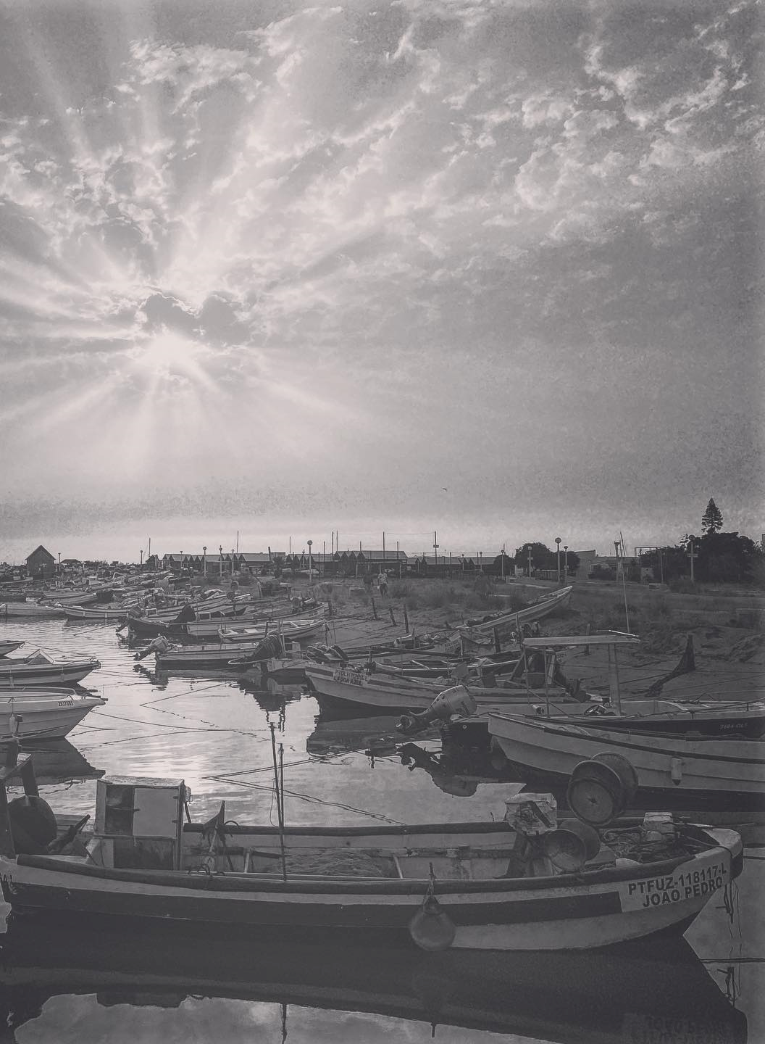
5
Energy Sharing Method
Slice the PV Generation Power
200 Wp Quotas
60 000
______
= 300
200
300 community buildings can take 1 quota of 200 Wp PV generation power
Fábio Buchinho Facebook

Slide 7
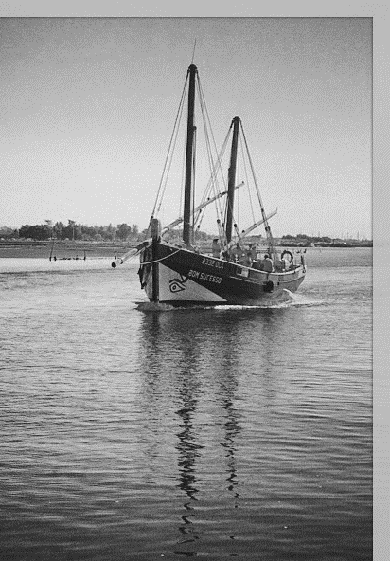
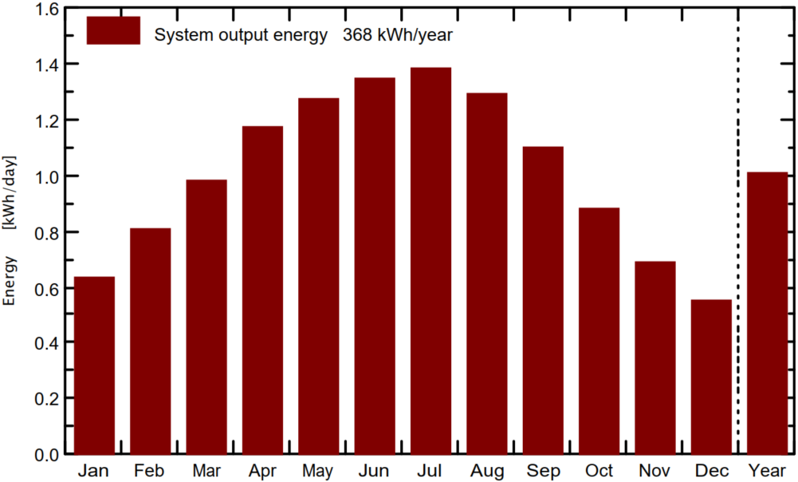
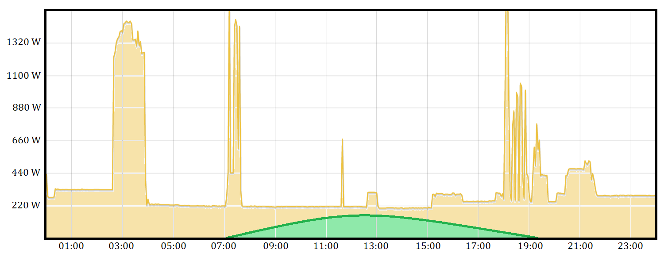
6
Energy Sharing 200 Wp Analysis
200 Wp Assessment
368 kWh / Year
80 € / Year
78.4 kg / Year
200 Wp Energy Generation Profile
Fábio Buchinho Facebook
Notes:
213 g CO2eq/kWh Portugal 23.5 tons of

Slide 8
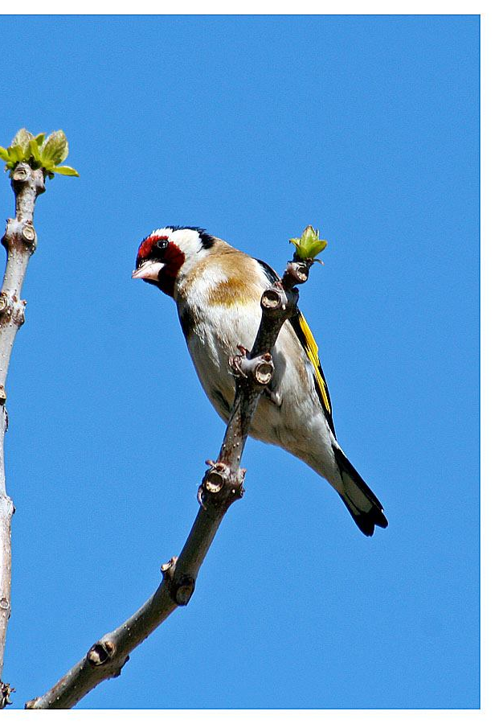
7
Energy Sharing Economic Model (200 Wp Quotas Price)
Prices per Wp
Others: 2 to 4 €
Coop: 1 € (200 €/quota)
Investment paid out in 2.5 years
Ready to use with no maintenance costs
Contribute to a 100% Autossustainable Culatra
Powered by Culatra Green Energy
7.5 years of profits
Fábio Buchinho Facebook

Slide 9
THANK YOU
SMILO ANNUAL CONFERENCE 2022 Tuesday, 27 september 2022
Notes:
Logotipo novo.

